Slide 1

THE EXECUTIVE PERFORMANCE SUITE
ABOUT THE EXECUTIVE DIAGNOSTICS
Three modules give CEOs and their teams the rare clarity to lead together and the evidence to act. Each pairs a structured diagnostic with a board-grade report.
Elevating executive effectiveness with data-driven insight
01 Executive Team Effectiveness · 02 Executive Bench Skills Matrix · 03 Executive Peer Feedback
Notes:
Open by framing the suite: three modules that give a CEO and executive team rare clarity on how they perform — collectively, as individuals, and as a capability set. Each pairs a structured instrument with a board-grade report.

Slide 2
A STRATEGIC TOOLKIT FOR EXECUTIVE TEAMS
Three modules, one picture of how the top team is performing
1
2
3
COLLECTIVE
CAPABILITY
INDIVIDUAL
Executive Team Effectiveness Review
Executive Bench Skills Matrix
Executive Peer Review
Identify bench strength relative to the key requirements for the CEO role and where succession gaps sit.
How each executive is experienced by the peers who work alongside them.
How the team performs as a collective — alignment, decisions, rhythm and culture.
Each module pairs a structured diagnostic with a board-grade report and data that can be interrogated over time.
Notes:
The three modules answer three different questions: how the team performs together, whether it has the capabilities the strategy needs, and how each leader is experienced by peers. Together they form one picture of executive effectiveness.

Slide 3
MODULE 1 · HOW IT WORKS
Executive Team Effectiveness Review
An evidence-based read on whether the leadership team as a collective is fit to deliver the strategy: the right people, operating in the right way.
WHAT IT MEASURES · SIX DIMENSIONS
1
Strategy & Alignment — aligned on the few priorities that decide whether the organisation wins
PARTICIPANTS
TIME
2
Capability & Bench — the collective capability and depth the strategy requires, now and next
All executive team members with the option of either direct reports or board members providing feedback.
~30 minutes
3
Decision-Making & Execution — high-quality decisions, made at the right speed, that get done
4
Change & Adaptability— sensing and responding to a volatile environment
BASIS
OUTPUT
5
Operating Rhythm & Focus — whether collective time and attention go to what matters
Confidential · Anonymised
Team effectiveness that can be tracked over time
6
Culture as a Performance Lever — candour, accountability and trust as drivers of execution
Notes:
Module 1 is the collective view. Confidential, multi-source, about 30 minutes. It scores six dimensions of how the team operates, with agreement ratings plus structured strengths and improvement areas.

Slide 4
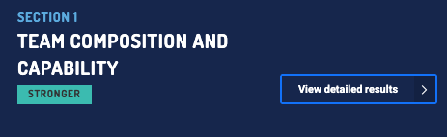
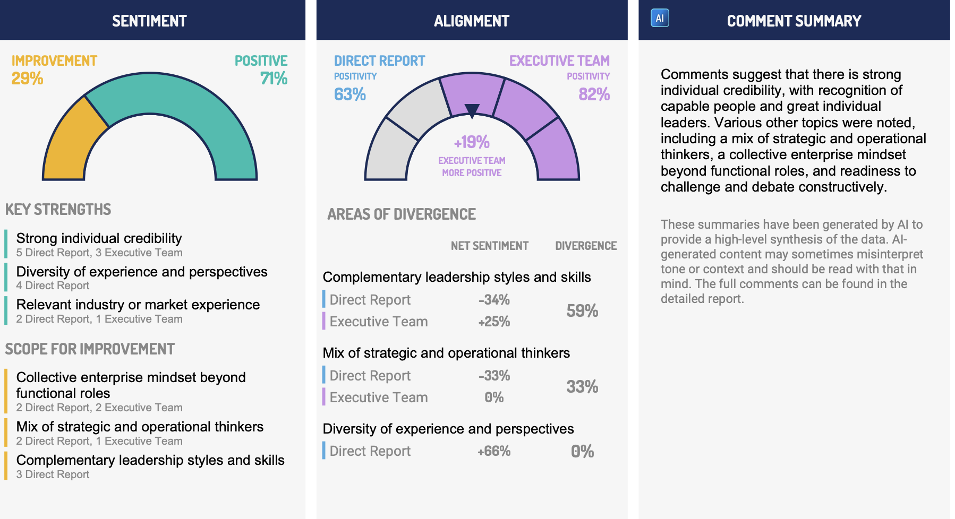
MODULE 1 · SAMPLE REPORT
Executive Team Effectiveness Review
Notes:
The team report scores each dimension as an agreement index and surfaces the structured strengths and drags. Here the team aligns on direction but loses time in how it runs — operating rhythm is the binding constraint.

Slide 5
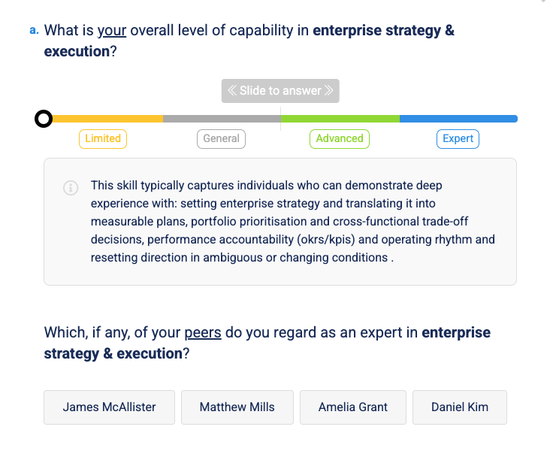
MODULE 2 · HOW IT WORKS
Executive Bench Skills Matrix
Maps the depth of skills and experience across the team against what the strategy demands of any future CEO — surfacing potential internal candidates and succession gaps.
EXAMPLES OF EXECUTIVE CAPABILITIES
Commercial & financial performance · Enterprise strategy & execution · Major change & transformation · AI, data & digital · Risk, resilience & crisis · Technology & cyber · Stakeholder & ecosystem · Innovation & business model · Safety & operational excellence · Sustainability & ESG · Major projects & capital · Government & policy · Talent, culture & leadership
PARTICIPANTS
SCOPE
Each executive, self-assessed with peer review to calibrate results.
Typically 12 to 15 capabilities customised to the organisation
SCALE
OUTPUT
Expert / Advanced / General / Limited
Coverage map + expert count per skill
Expert
Advanced
General
Limited
Notes:
Module 2 maps capability depth. Each executive self-assesses across 13 capabilities — five critical, eight general — at four proficiency levels. The platform computes coverage and how many genuine experts back each capability.

Slide 6
MODULE 2 · SAMPLE REPORT
Executive Bench Skills Matrix · 2026
SUMMARY
Two critical-risk gaps have no experts : Government & policy and Talent & culture. AI & digital and Risk each rest on a single expert — concentration risk if that person leaves.
OH
AG
DK
JM
MM
EXPERTS
Olivia Hart
Amelia Grant
Daniel Kim
James McAllister
Matthew Mills
CEO
FIN. CONTROLLER
REGIONAL GM
CFO
CHRO
CAPABILITIES
Commercial & financial performance
EXP
EXP
ADV
EXP
EXP
4
Enterprise strategy & execution
EXP
EXP
ADV
ADV
ADV
2
Major change & transformation delivery
ADV
ADV
EXP
EXP
ADV
2
AI, data & digital transformation
LIM
ADV
EXP
GEN
ADV
1
Risk, resilience & crisis
LIM
ADV
EXP
GEN
ADV
1
CAPABILITIES
Technology, cyber & information security
EXP
EXP
EXP
GEN
ADV
3
Stakeholder & ecosystem
ADV
GEN
EXP
EXP
EXP
3
Innovation & business model evolution
EXP
ADV
LIM
EXP
GEN
2
Safety & operational excellence
ADV
ADV
GEN
GEN
EXP
1
Sustainability & ESG integration
LIM
ADV
GEN
ADV
EXP
1
Major projects & capital program delivery
ADV
LIM
LIM
EXP
LIM
1
Government, regulatory & policy engagement
ADV
GEN
ADV
GEN
ADV
0
Talent, culture & leadership
GEN
LIM
ADV
ADV
ADV
0
Notes:
The matrix shows every executive's level across each capability, with an expert count per row. Two critical-risk gaps stand out: Government and policy and Talent and culture have no experts at all, and AI and Risk each rest on a single person.

Slide 7
MODULE 3 · HOW IT WORKS
Executive Peer Review
Individual, multi-perspective feedback on how each executive enables or blocks the team's ability to execute, drawn from the peers who work alongside them.
WHAT IT MEASURES · THREE DOMAINS
1
Strategic Leadership & Results — strategic thinking, enterprise focus and drive for outcomes
STEP 1
STEP 2
2
Leading People & Building Capability — developing talent, holding standards, building bench
Self-evaluation provides for greater self-awareness
Anonymous feedback from peers
3
Enterprise Contribution & Collaboration — strengthening the whole team, not just one function
TIME
OUTPUT
+
Additional feedback— most valuable contribution and one change to make
~5–8 minutes per executive
Individual profile · Self-vs-peer gaps · Aggregate reporting available
Notes:
Module 3 is the individual peer view. A short, anonymous instrument — five to eight minutes per executive — drawn from the peers who work alongside them, with a self-evaluation step that highlights where self-view and peer-view diverge.

Slide 8
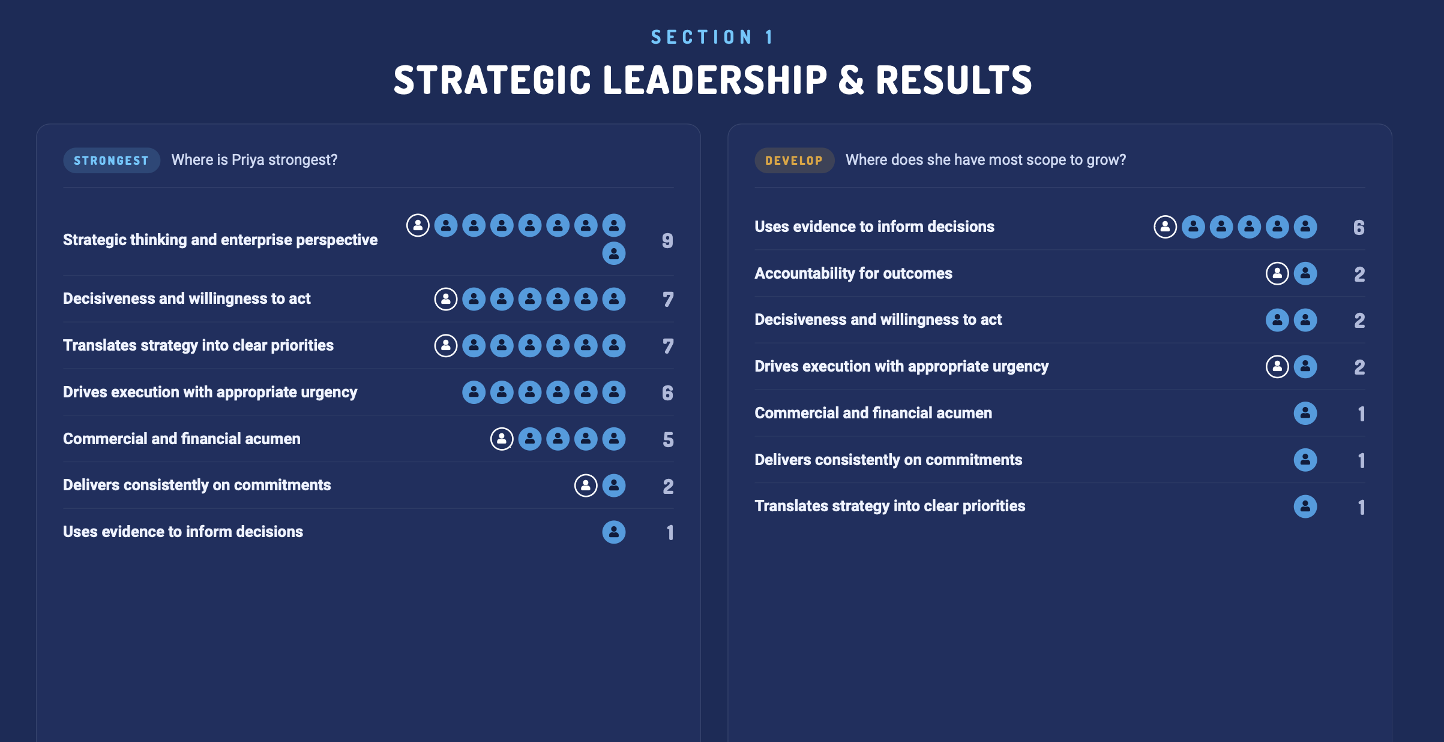
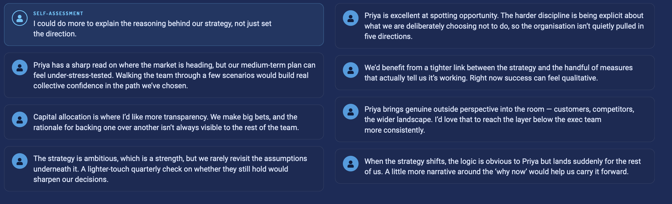
MODULE 3 · SAMPLE REPORT — INDIVIDUAL
Each marker is one respondent who selected that area
The report each executive receives
Notes:
This is the mock report an individual executive receives — their own confidential 360 profile. For each capability, respondents marked where the person is strongest and where they have most scope to grow. Each marker is one respondent. Priya, the CEO, scores highest on strategic thinking; her clearest development theme is using evidence to inform decisions.

Slide 9
MODULE 3 · SAMPLE REPORT — AGGREGATE
Executive Peer Feedback
DIAGNOSTIC SUMMARY
Peers rate the team highest on strategic thinking (+31). The softest signals are use of evidence (+3) and decisiveness (+13) — and Marcus Bell drives execution hard but scores low on delivery and evidence.
Aggregate Report
Section 1 · Strategic Leadership & Results · net strength score by executive
PR
DO
HV
MB
AK
TR
GL
SA
NP
TOTAL
Priya Raman
Daniel Okafor
Helena Vance
Marcus Bell
Aisha Khan
Thomas Reid
Grace Lin
Samuel Adeyemi
Nadia Petrov
CEO
CFO
COO
CTO
CPO
CCO
CSO
CLO
CMO
Drives execution with appropriate urgency
+1
+4
0
+8
+5
+6
0
+2
+2
28
Strategic thinking & enterprise perspective
+5
+7
-2
+5
+7
+6
+2
-2
+3
31
Delivers consistently on commitments
+5
+7
+5
-6
+1
+1
+5
+5
23
Decisiveness & willingness to act
0
+3
-5
+6
-2
+6
-3
+5
+3
13
Accountability for outcomes
+5
0
-3
+3
-1
+4
+3
+3
+4
18
Translates strategy into clear priorities
+4
+2
+3
+5
0
-1
+6
+1
+6
26
Commercial & financial acumen
+3
+1
-1
-1
+5
+3
+4
+2
+3
19
Uses evidence to inform decisions
+1
0
-1
-5
+1
0
+4
+3
3
Notes:
This is one section of an executive's peer matrix — Strategic Leadership and Results, scored across all nine executives. Green is strength, amber is development. The team is strong on strategic thinking but use-of-evidence and decisiveness are the soft spots.

